Slide 1



DATA PORTFOLIO CASE STUDY
Customer Shopping Behavior Analysis
Leveraging transaction analytics from 3,900 purchases to guide retail marketing campaign design and corporate strategy.
ENVIRONMENT
Python & PostgreSQL

Slide 2


Strategic Positioning
Project Overview
Executive Case Summary
Targeted Project Objectives
This analytics case investigates purchase histories across 25 distinct consumer lines. By analyzing key demographics, subscription commitments, and regional purchase schedules, the system identifies structural revenue channels to improve customer acquisition and loyalty.
Key focus areas include identifying high-spending discount users, mapping seasonal behavior variations, and analyzing localized transaction paths. This allows the business to transition standard buyers into repeat, loyal subscription accounts, protecting baseline margins.

Slide 3



Information Architecture
Dataset Summary
Analyzing a clean, structured transactional ledger tracking user attributes, detailed order categories, and verified historical records.
Comprehensive
Transaction
Data
Customer
Demographics &
Behavior
3,900
18
37
Only In Review
Rating Column
TOTAL TRANSACTIONS
CORE ATTRIBUTES
MISSING RATINGS IMPUTED
Row count validation
Dimensional features
Review rating columns

Slide 4





Relational Pipeline
Data Preparation Process
Data Ingestion
Exploration
Imputation
Feature Engineering
PostgreSQL Load
Imported unstructured purchase datasets using python Pandas framework.
Derived baseline statistics using descriptive summary and schema structure calls.
Imputed 37 missing ratings using category median metrics for consistency.
Constructed customer age cohorts and normalized snake_case formats.
Exported structured clean database records into Postgres schema.

Slide 5

Data Science Overview
Exploratory Data Analysis
Metric | Customer ID | Age | Purchase Amount (USD) | Review Rating | Previous Purchases
Mean Metric | 1950.50 | 44.07 Yrs | $59.76 | 3.75 / 5.0 | 25.35 purchases
Standard Deviation (Std) | 1125.98 | 15.21 Yrs | $23.69 | 0.72 | 14.45
Minimum value | 1.00 | 18.00 Yrs | $20.00 | 2.50 / 5.0 | 1.00
Median value (50%) | 1950.50 | 44.00 Yrs | $60.00 | 3.80 / 5.0 | 25.00
Maximum value | 3900.00 | 70.00 Yrs | $100.00 | 5.00 / 5.0 | 50.00

Slide 6
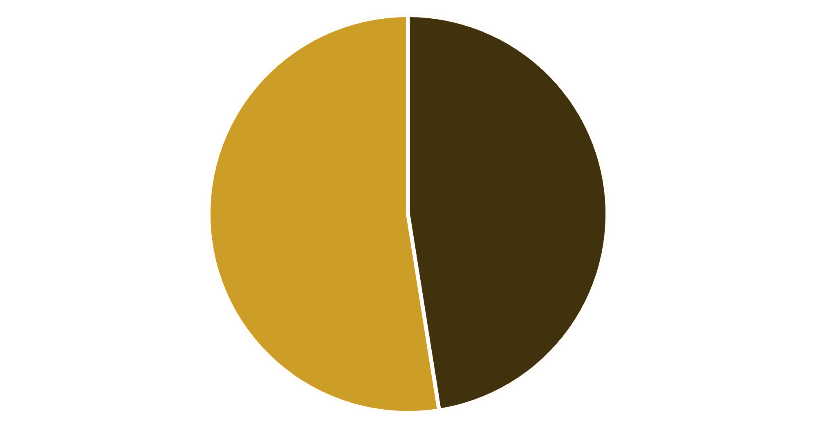


Gender Contribution
Revenue by Gender Analysis
$157K
$75K
MALE SPENDS
FEMALE SPENDS
Male shoppers generate significantly higher total revenue, accounting for over two-thirds of total transactions. However, average transaction sizes remain consistent, presenting an expansion opportunity for female demographic segments.
Female
Male

Slide 7



Cohort Classifications
Customer Segmentation
Cohort Retention Focus
The dataset is highly concentrated with a reliable base of 3,116 loyal buyers. This highlights a clear strategic mandate: design high-impact onboarding pipelines to convert first-time buyers into loyal repeat purchasers.
Strategic Goal: Convert New to Returning, and Returning to Loyal.

Slide 8

Promotion Optimization
High-Spending Discount Users
Strategic Promotion Opportunities
839
Our database identifies 839 high-value shoppers who actively apply discount coupons but consistently maintain above-average transaction values ($59.76).
SMART SHOPPERS
Rather than offering generic price markdowns that erode margins, incentivize this cohort using exclusive premium benefits and checkout loyalty rewards.
Promotional coupon redeemers spending
above standard average levels.

Slide 9



Quality Index Ledger
Top-Rated Products
Rank 01
Rank 02
Rank 03
Gloves
Sandals
Boots
3.86 / 5.0
3.84 / 5.0
3.82 / 5.0
"Highest review satisfaction rating across all clothing accessory lines."
"Consistently strong ratings, representing a key seasonal footwear option."
"Top-tier autumn and winter category choice, driving premium margins."

Slide 10
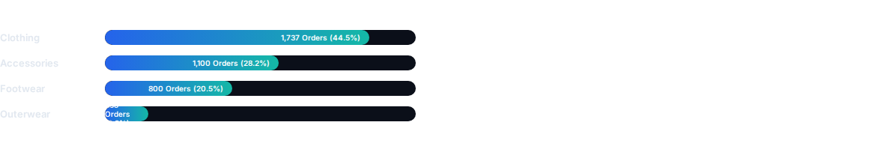

Department Analysis
Department Performance
1,737
CLOTHING ORDERS
Primary revenue segment
Clothing dominates transactional volume, representing nearly half of all customer orders. High-rated accessory categories offer significant cross-selling potential.

Slide 11


Recurring Revenue
Subscription Analysis
Comparing order trends and average spending habits between subscription members and standard non-subscribers.
$59.49
$59.87
SUBSCRIPTION SPEND
STANDARD SPEND
Avg: 1,053 Active Members
Avg: 2,847 Standard Users
Total: $62,645.00
Total: $170,436.00
Spending amounts align closely across both cohorts, highlighting a clear need to improve membership benefits with exclusive packaging and rewards.

Slide 12
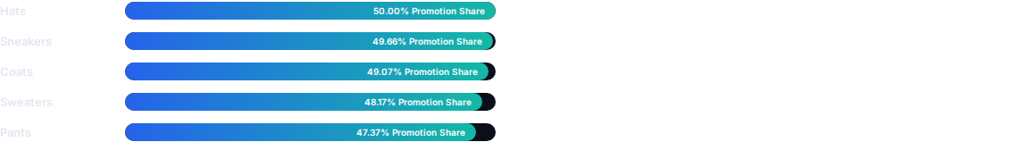
Promotional Elasticity
Discount Dependencies
Reviewing Promotional Policies
Several core product segments, including hats and footwear, show a high dependency on discount campaigns to drive transaction volume.
Over half of all hat transactions rely on discount codes. Gradually shifting these lines toward value-add bundles can help protect core pricing margins.

Slide 13



Fulfilment Channels
Shipping Type Comparison
Evaluating transaction values across standard and expedited shipping options highlights clear differences in customer price sensitivity.
$60.48
$58.46
EXPRESS DELIVERY
STANDARD DELIVERY
Average purchase size
Average purchase size
Express delivery customers display a higher willingness to spend.

Slide 14
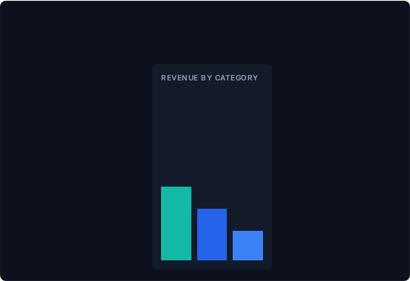




Interactive BI Suite
Power BI Dashboard
FILTERS
ACTIVE BUYERS
452
AVERAGE SPEND
$60.46
REVENUE BY AGE GROUP
Interactive Portfolio Dashboard
Our business intelligence suite displays key performance indicators, segment filters, and demographic dimensions in a unified dashboard.
Users can easily explore regional categories, discount dependencies, and purchase frequencies to inform marketing and product placement decisions.

Slide 15
Corporate Action Blueprint
Strategic Recommendations
Boost Subscription Perks: Promote members-only packaging and priority express delivery thresholds to naturally convert non-subscribers into active recurring users.
Customer Loyalty Systems: Construct targeted transactional milestones and points rewards to steadily guide new buyers into high-value repeat segments.
Review Discount Policies: Carefully review discount dependencies across key categories (e.g., Hats, Footwear), replacing broad markdowns with value-add bundles.
Product Placement Campaigns: Emphasize highly-rated and popular collections (Gloves, Sandals) in regional seasonal marketing assets.
Targeted Marketing Spend: Focus marketing efforts on high-revenue age segments, leveraging express delivery benefits to naturally increase Average Order Value (AOV).

